Slide 1


Fact Verification with Semi-Structured Knowledge
Yi-Lin Tuan, Wenhu Chen,William Wang

Slide 2
Outline
Background
Related Work
FEVER Pipeline
TabFact
Conclusion

Slide 3
Misinformation
Our society is struggling with an unprecedented amount of falsehood, hyperbole, and half-truths.

Slide 4
Misinformation
Our society is struggling with an unprecedented amount of falsehood, hyperbole, and half-truths.
Politicians and organizations repeatedly make false claims that jeopardize the integrity of journalism.

Slide 5
Fact Verification
To fight false information, the need for fact verification has never been so urgent.

Slide 6
Fact Verification
To fight false information, the need for fact verification has never been so urgent.
The number of fact-checking organization has grown from 44 in 2014 to 115 in 2017

Slide 7
Fact Verification
﻿The challenge is that the human fact-checkers cannot keep up with the amount of misinformation and the speed at which it spreads.

Slide 8
Fact Verification
﻿The challenge is that the human fact-checkers cannot keep up with the amount of misinformation and the speed at which it spreads.
We need automatic tools or techniques to help us in fact-checking in various areas

Slide 9
Fact Verification
﻿The challenge is that the human fact-checkers cannot keep up with the amount of misinformation and the speed at which it spreads.
We need automatic tools or techniques to help us in fact-checking in various areas
ClaimBuster (﻿Naeemul et al. 2019) is invented as the first end-to-end fact-checking system.

Slide 10
Related Research
Fact Verification can be viewed as a natural language understanding problem.
World
Evidence
Entailed/
Refuted
Textual Hypothesis

Slide 11
Related Research
Fact Verification can be viewed as a natural language understanding problem.
Verify textual statement given the world knowledge as evidence.
World
Evidence
Entailed/
Refuted
Textual Hypothesis

Slide 12
Related Research
Recognizing Textual Entailment (Dagan et al. 2006)
Recognizing whether the meaning of the first sentence is contained in the second sentence.

Slide 13
Related Research
Recognizing Textual Entailment (Dagan et al. 2006)
Recognizing whether the meaning of the first sentence is contained in the second sentence.
Natural Language Inference (Bowman et al. 2015)
Recognizing whether a premise text can entail another hypothesis text.
Notes:
Difference?

Slide 14
Related Research
Recognizing Textual Entailment (Dagan et al. 2006)
Recognizing whether the meaning of the first sentence is contained in the second sentence.
Natural Language Inference (Bowman et al. 2015)
Recognizing whether a premise text can entail another hypothesis text.
Text Fragments
Entailed/
Refuted
Textual Hypothesis

Slide 15
Related Research
Claim Verification (Popat et al. 2017)
Verify claims from social media

Slide 16
Related Research
Claim Verification (Popat et al. 2017)
Verify claims from social media
Fact Checking (Thorne et al. 2018)
Verify claims modified from Wikipedia

Slide 17
Related Research
Claim Verification (Popat et al. 2017)
Verify claims from social media
Fact Checking (Thorne et al. 2018)
Verify claims modified from Wikipedia
Entailed/
Refuted
Textual Hypothesis
Passage

Slide 18
FEVER
Given:
5 million Wikipedia documents
Statement
Output:
Verdict: (SUPPORT, REFUTE, NOT ENOUGH INFO)
The dataset simulates the real-world fact-checking and extraction scenarios.

Slide 19
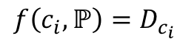
FEVER
Document Retrieval
TF-IDF
BM25
Keyword Matching
$$f\left(c_{i},ℙ\right)=D_{c_{i}}$$

Slide 20
FEVER
Document Retrieval
TF-IDF
BM25
Keyword Matching
$$f\left(c_{i},ℙ\right)=D_{c_{i}}$$
Wikipedia
Documents

Slide 21
FEVER
Document Retrieval
TF-IDF
BM25
Keyword Matching
$$f\left(c_{i},ℙ\right)=D_{c_{i}}$$
Wikipedia
Documents
Claim

Slide 22
FEVER
Document Retrieval
TF-IDF
BM25
Keyword Matching
$$f\left(c_{i},ℙ\right)=D_{c_{i}}$$
Retrieved Evidence
Wikipedia
Documents
Claim

Slide 23
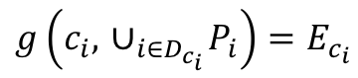
FEVER
Sentence Retriever
Semantic Matching
$$g\left(c_{i},{ ∪}_{i∈D_{c_{i}}}P_{i}\right)=E_{c_{i}}$$
Notes:
Notation (i)

Slide 24
FEVER
Sentence Retriever
Semantic Matching
$$g\left(c_{i},{ ∪}_{i∈D_{c_{i}}}P_{i}\right)=E_{c_{i}}$$
Retrieved Evidence
Notes:
Notation (i)

Slide 25
FEVER
Sentence Retriever
Semantic Matching
$$g\left(c_{i},{ ∪}_{i∈D_{c_{i}}}P_{i}\right)=E_{c_{i}}$$
Claim
Retrieved Evidence
Notes:
Notation (i)

Slide 26
FEVER
Sentence Retriever
Semantic Matching
$$g\left(c_{i},{ ∪}_{i∈D_{c_{i}}}P_{i}\right)=E_{c_{i}}$$
Sentences
Claim
Retrieved Evidence

Slide 27
FEVER
Sentence Retriever
Semantic Matching
$$g\left(c_{i},{ ∪}_{i∈D_{c_{i}}}P_{i}\right)=E_{c_{i}}$$
Sentences
Claim
Rank
Network
Retrieved Evidence

Slide 28
FEVER
Sentence Retriever
Semantic Matching
$$g\left(c_{i},{ ∪}_{i∈D_{c_{i}}}P_{i}\right)=E_{c_{i}}$$
Sentences
Claim
Rank
Network
Retrieved Evidence

Slide 29
FEVER
Sentence Retriever
Semantic Matching
$$g\left(c_{i},{ ∪}_{i∈D_{c_{i}}}P_{i}\right)=E_{c_{i}}$$
Retrieved Sentence
Claim
Retrieved Evidence

Slide 30
FEVER
Verifier (NLI)
Retrieved Sentence
Claim
Network

Slide 31
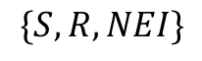
FEVER
Verifier (NLI)
Retrieved Sentence
Claim
Network
$$\{S, R, NEI\}$$

Slide 32
Free-form Evidence
Fever simulates a realistic open-domain verification testbed for fact verification based on publicly available free-form language evidence.

Slide 33
Free-form Evidence
Fever simulates a realistic open-domain verification testbed for fact verification based on publicly available free-form language evidence.
Can we go further to utilize other publicly available
evidence for fact verification?

Slide 34
What else can we leverage
Source: https://en.wikipedia.org/wiki/Houston_Rockets
Claim:
Houston Rocket won 45% of the game in 12-13 season.

Slide 35
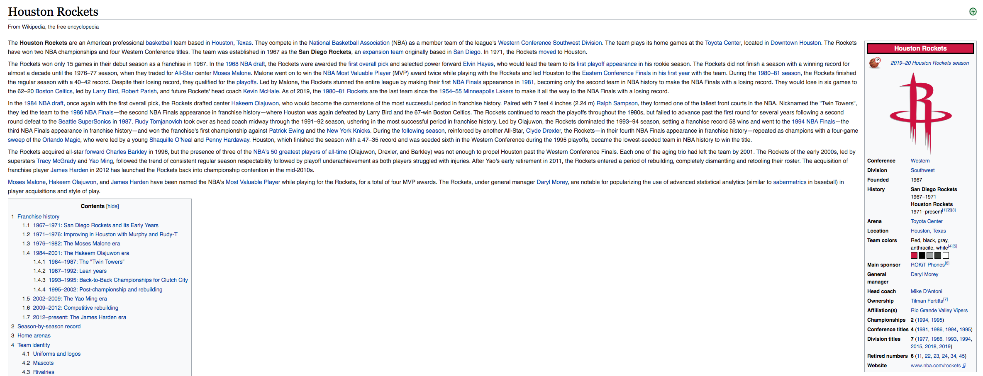
What else can we leverage
Source: https://en.wikipedia.org/wiki/Houston_Rockets
Claim:
Houston Rocket won 45% of the game in 12-13 season.

Slide 36
What else can we leverage
Source: https://en.wikipedia.org/wiki/Houston_Rockets
Claim:
Houston Rocket won 45 games in 12-13 season.

Slide 37
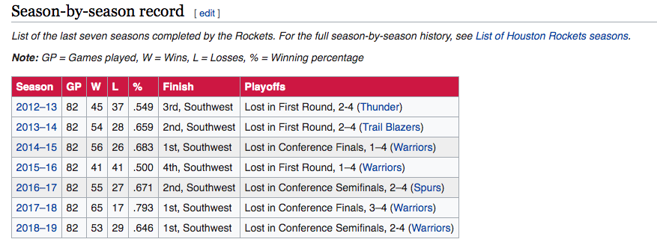
What else can we leverage
Source: https://en.wikipedia.org/wiki/Houston_Rockets
Claim:
Houston Rocket won 45 games in 12-13 season.

Slide 38
What else can we leverage
Free-form evidence is sometimes not sufficient.
Under many circumstances, we need to resort to other evidence forms to do fact verification.

Slide 39
Structured Evidence
Existing work mainly considers free-form language as evidence representation

Slide 40
Structured Evidence
Existing work mainly considers free-form language as evidence representation
Structured data is also ubiquitous form of world knowledge like

Slide 41
Structured Evidence
Existing work mainly considers free-form language as evidence representation
Structured data is also ubiquitous form of world knowledge like Table
ID | Name | Age
1 | xxx | 12
2 | yyy | 13
3 | zzz | 14

Slide 42
Structured Evidence
Existing work mainly considers free-form language as evidence representation
Structured data is also ubiquitous form of world knowledge like Graph, Table, HTML/XML, etc.
ID | Name | Age
1 | xxx | 12
2 | yyy | 13
3 | zzz | 14
<University>
<Student Id=“1”>
<Age>18</Age>
<Name>Chen</Name>
</Student>
</University>
Name
ID
Student
Teacher
Age
Notes:
Examples for the three types of structured knowledge

Slide 43
Structured Evidence
Existing work mainly considers free-form language as evidence representation
Structured data is also ubiquitous form of world knowledge like Graph, Table, HTML/XML, etc.
ID | Name | Age
1 | xxx | 12
2 | yyy | 13
3 | zzz | 14
<University>
<Student Id=“1”>
<Age>18</Age>
<Name>Chen</Name>
</Student>
</University>
Name
ID
Student
Teacher
Age

Slide 44
Fact Verification on Semi-structured Tables
We explore the fact verification problem under semi-structured Wikipedia tables.
Ubiquitous in real-world applications
Contain both structured and un-structured forms

Slide 45
Fact Verification on Semi-structured Tables
We explore the fact verification problem under semi-structured Wikipedia tables.
Ubiquitous in real-world applications
Contain both structured and un-structured forms
TabFact Dataset
16K open-domain Wikipedia tables
118K human-annotated statements divided into entailed or refuted categories.

Slide 46
TabFact Examples
United States House of Representatives Elections, 1972
District | Incumbent | Party | Result | Candidates
California 3 | John E. Moss | democratic | re-elected | John E. Moss (d) 69.9% John Rakus (r) 30.1%
California 5 | Phillip Burton | democratic | re-elected | Phillip Burton (d) 81.8% Edlo E. Powell (r) 18.2%
California 8 | George Paul Miller | democratic | lost renomination democratic hold | Pete Stark (d) 52.9% Lew M. Warden , Jr. (r) 47.1%
California 14 | Jerome R. Waldie | republican | re-elected | Jerome R. Waldie (d) 77.6% Floyd E. Sims (r) 22.4%
California 15 | John J. Mcfall | republican | re-elected | John J. Mcfall (d) unopposed

Slide 47
TabFact Examples
United States House of Representatives Elections, 1972
District | Incumbent | Party | Result | Candidates
California 3 | John E. Moss | democratic | re-elected | John E. Moss (d) 69.9% John Rakus (r) 30.1%
California 5 | Phillip Burton | democratic | re-elected | Phillip Burton (d) 81.8% Edlo E. Powell (r) 18.2%
California 8 | George Paul Miller | democratic | lost renomination democratic hold | Pete Stark (d) 52.9% Lew M. Warden , Jr. (r) 47.1%
California 14 | Jerome R. Waldie | republican | re-elected | Jerome R. Waldie (d) 77.6% Floyd E. Sims (r) 22.4%
California 15 | John J. Mcfall | republican | re-elected | John J. Mcfall (d) unopposed
1. John E. Moss and Phillip Burton are both re-elected in the house of representative election in 1972.

Slide 48
TabFact Examples
United States House of Representatives Elections, 1972
District | Incumbent | Party | Result | Candidates
California 3 | John E. Moss | democratic | re-elected | John E. Moss (d) 69.9% John Rakus (r) 30.1%
California 5 | Phillip Burton | democratic | re-elected | Phillip Burton (d) 81.8% Edlo E. Powell (r) 18.2%
California 8 | George Paul Miller | democratic | lost renomination democratic hold | Pete Stark (d) 52.9% Lew M. Warden , Jr. (r) 47.1%
California 14 | Jerome R. Waldie | republican | re-elected | Jerome R. Waldie (d) 77.6% Floyd E. Sims (r) 22.4%
California 15 | John J. Mcfall | republican | re-elected | John J. Mcfall (d) unopposed
1. John E. Moss and Phillip Burton are both re-elected in the house of representative election in 1972.

Slide 49
TabFact Examples
United States House of Representatives Elections, 1972
District | Incumbent | Party | Result | Candidates
California 3 | John E. Moss | democratic | re-elected | John E. Moss (d) 69.9% John Rakus (r) 30.1%
California 5 | Phillip Burton | democratic | re-elected | Phillip Burton (d) 81.8% Edlo E. Powell (r) 18.2%
California 8 | George Paul Miller | democratic | lost renomination democratic hold | Pete Stark (d) 52.9% Lew M. Warden , Jr. (r) 47.1%
California 14 | Jerome R. Waldie | republican | re-elected | Jerome R. Waldie (d) 77.6% Floyd E. Sims (r) 22.4%
California 15 | John J. Mcfall | republican | re-elected | John J. Mcfall (d) unopposed
2. In the election, four out of five incumbents are re-elected.

Slide 50
TabFact Examples
United States House of Representatives Elections, 1972
District | Incumbent | Party | Result | Candidates
California 3 | John E. Moss | democratic | re-elected | John E. Moss (d) 69.9% John Rakus (r) 30.1%
California 5 | Phillip Burton | democratic | re-elected | Phillip Burton (d) 81.8% Edlo E. Powell (r) 18.2%
California 8 | George Paul Miller | democratic | lost renomination democratic hold | Pete Stark (d) 52.9% Lew M. Warden , Jr. (r) 47.1%
California 14 | Jerome R. Waldie | republican | re-elected | Jerome R. Waldie (d) 77.6% Floyd E. Sims (r) 22.4%
California 15 | John J. Mcfall | republican | re-elected | John J. Mcfall (d) unopposed
2. In the election, four out of five incumbents are re-elected.

Slide 51
TabFact Examples
United States House of Representatives Elections, 1972
District | Incumbent | Party | Result | Candidates
California 3 | John E. Moss | democratic | re-elected | John E. Moss (d) 69.9% John Rakus (r) 30.1%
California 5 | Phillip Burton | democratic | re-elected | Phillip Burton (d) 81.8% Edlo E. Powell (r) 18.2%
California 8 | George Paul Miller | democratic | lost renomination democratic hold | Pete Stark (d) 52.9% Lew M. Warden , Jr. (r) 47.1%
California 14 | Jerome R. Waldie | republican | re-elected | Jerome R. Waldie (d) 77.6% Floyd E. Sims (r) 22.4%
California 15 | John J. Mcfall | republican | re-elected | John J. Mcfall (d) unopposed
3. John E. Moss and George Paul Miller are both re-elected in the house of representative election.

Slide 52
TabFact Examples
United States House of Representatives Elections, 1972
District | Incumbent | Party | Result | Candidates
California 3 | John E. Moss | democratic | re-elected | John E. Moss (d) 69.9% John Rakus (r) 30.1%
California 5 | Phillip Burton | democratic | re-elected | Phillip Burton (d) 81.8% Edlo E. Powell (r) 18.2%
California 8 | George Paul Miller | democratic | lost renomination democratic hold | Pete Stark (d) 52.9% Lew M. Warden , Jr. (r) 47.1%
California 14 | Jerome R. Waldie | republican | re-elected | Jerome R. Waldie (d) 77.6% Floyd E. Sims (r) 22.4%
California 15 | John J. Mcfall | republican | re-elected | John J. Mcfall (d) unopposed
3. John E. Moss and George Paul Miller are both re-elected in the house of representative election.

Slide 53
TabFact Examples
United States House of Representatives Elections, 1972
District | Incumbent | Party | Result | Candidates
California 3 | John E. Moss | democratic | re-elected | John E. Moss (d) 69.9% John Rakus (r) 30.1%
California 5 | Phillip Burton | democratic | re-elected | Phillip Burton (d) 81.8% Edlo E. Powell (r) 18.2%
California 8 | George Paul Miller | democratic | lost renomination democratic hold | Pete Stark (d) 52.9% Lew M. Warden , Jr. (r) 47.1%
California 14 | Jerome R. Waldie | republican | re-elected | Jerome R. Waldie (d) 77.6% Floyd E. Sims (r) 22.4%
California 15 | John J. Mcfall | republican | re-elected | John J. Mcfall (d) unopposed
4. There are five candidates in total, two of them are democrats and three of them are republicans.

Slide 54
TabFact Examples
United States House of Representatives Elections, 1972
District | Incumbent | Party | Result | Candidates
California 3 | John E. Moss | democratic | re-elected | John E. Moss (d) 69.9% John Rakus (r) 30.1%
California 5 | Phillip Burton | democratic | re-elected | Phillip Burton (d) 81.8% Edlo E. Powell (r) 18.2%
California 8 | George Paul Miller | democratic | lost renomination democratic hold | Pete Stark (d) 52.9% Lew M. Warden , Jr. (r) 47.1%
California 14 | Jerome R. Waldie | republican | re-elected | Jerome R. Waldie (d) 77.6% Floyd E. Sims (r) 22.4%
California 15 | John J. Mcfall | republican | re-elected | John J. Mcfall (d) unopposed
4. There are five candidates in total, two of them are democrats and three of them are republicans.

Slide 55
Challenges
Mixed Reasoning in Semi-structured Input

Slide 56
Challenges
Mixed Reasoning in Semi-structured Input
Linguistic Reasoning on semantic-level
Result | Candidates
re-elected | John E. Moss (d) 69.9% John Rakus (r) 30.1%
re-elected | Phillip Burton (d) 81.8% Edlo E. Powell (r) 18.2%
lost renomination democratic hold | Pete Stark (d) 52.9% Lew M. Warden , Jr. (r) 47.1%
re-elected | Jerome R. Waldie (d) 77.6% Floyd E. Sims (r) 22.4%
re-elected | John J. Mcfall (d) unopposed

Slide 57
Challenges
Mixed Reasoning in Semi-structured Input
Linguistic Reasoning on semantic-level
Symbolic Reasoning on structure-level
Result | Candidates
re-elected | John E. Moss (d) 69.9% John Rakus (r) 30.1%
re-elected | Phillip Burton (d) 81.8% Edlo E. Powell (r) 18.2%
lost renomination democratic hold | Pete Stark (d) 52.9% Lew M. Warden , Jr. (r) 47.1%
re-elected | Jerome R. Waldie (d) 77.6% Floyd E. Sims (r) 22.4%
re-elected | John J. Mcfall (d) unopposed
District | Incumbent | Party
California 3 | John E. Moss | democratic
California 5 | Phillip Burton | democratic
California 8 | George Paul Miller | democratic
California 14 | Jerome R. Waldie | republican
California 15 | John J. Mcfall | republican

Slide 58
Models
Latent Program Analysis
Semantic-parsing baseline
Synthesize the latent logic forms for the statement and execute the logic form against table to verify.
Table BERT
NLI baseline
Linearize the table as paragraph of sentences, then use large-scale pre-trained language model to verify.

Slide 59
Latent Program Analysis
Latent Program Analysis
There are more democrats than republicans in the election.
Table

Slide 60
Latent Program Analysis
Latent Program Analysis
There are more democrats than republicans in the election.
Feature-based Entity Linking
Search
Table

Slide 61
Latent Program Analysis
Latent Program Analysis
There are more democrats than republicans in the election.
Feature-based Entity Linking
Search
Table
String
incumbent
democratic
incumbent
republican
Notes:
Change the keys

Slide 62
Latent Program Analysis
Latent Program Analysis
There are more democrats than republicans in the election.
Feature-based Entity Linking
Search
Table
String
Party
democratic
Party
republican
V1=Filter(T, incumbent==democratic))
View
Sub
V1

Slide 63
Latent Program Analysis
Latent Program Analysis
There are more democrats than republicans in the election.
Feature-based Entity Linking
Search
Table
String
Party
republican
Sub
V1
V2=Filter(T, incumbent==republican))
View
Sub
V2

Slide 64
Latent Program Analysis
Latent Program Analysis
There are more democrats than republicans in the election.
Feature-based Entity Linking
Search
Party
democratic
democratic
democratic
republican
republican
Table
Sub
V1
Sub
V2
3=Count(V1)
Num
Count
3

Slide 65
Latent Program Analysis
Latent Program Analysis
There are more democrats than republicans in the election.
Feature-based Entity Linking
Search
Party
democratic
democratic
democratic
republican
republican
Table
Sub
V2
Count
3
2=Count(V2)
Num
Count
2

Slide 66
Latent Program Analysis
Latent Program Analysis
There are more democrats than republicans in the election.
Feature-based Entity Linking
Search
Party
democratic
democratic
democratic
republican
republican
Table
Count
3
Count
2
Greater(3, 2)
Bool
True
Entailed

Slide 67
Latent Program Analysis
BFS to search for potential programs
Root
Func
Func
Func
Func
Func
Func
Func
Func
Func

Slide 68
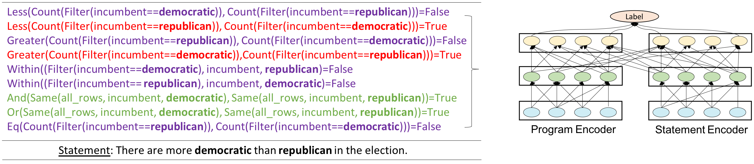
Latent Program Analysis
Program Re-Ranking

Slide 69
Latent Program Analysis
Program Re-Ranking

Slide 70
Latent Program Analysis
Program Re-Ranking

Slide 71
Table-BERT
Scanning the Table
Game | Date | Opponent | Score
51 | February 3 , 2009 | Florida | 3-4
52 | February 4 , 2009 | Buffalo | 0-5
53 | February 7 , 2010 | Montreal | 5-2
Horizontal Scan

Slide 72
Table-BERT
Scanning the Table
Game | Date | Opponent | Score
51 | February 3 , 2009 | Florida | 3-4
52 | February 4 , 2009 | Buffalo | 0-5
53 | February 7 , 2010 | Montreal | 5-2
Horizontal Scan
Row one game is 51, date is February 3, 2009 … Row two
Game is 52, date is February 4, 2009, …

Slide 73
Table-BERT
Template the table with natural language
Word
[CLS]
row
one
game
is
51
;
date
is
February
3
Position
0
1
2
3
4
5
6
7
8
9
10

Slide 74
Table-BERT
Concatenate the statement
Word
[CLS]
row
one
game
[SEP]
in
the
game
Position
0
1
2
3
10
11
12
13
Table
Statement

Slide 75
Table-BERT
BERT NLI Framework
Label
12-Layer BERT-Base Model
Word
[CLS]
row
one
game
[SEP]
in
the
game
Position
0
1
2
3
10
11
12
13
Table
Statement

Slide 76
Table-BERT
BERT NLI Framework
Support
Refute
Label
12-Layer BERT-Base Model
Word
[CLS]
row
one
game
[SEP]
in
the
game
Position
0
1
2
3
10
11
12
13
Table
Statement

Slide 77
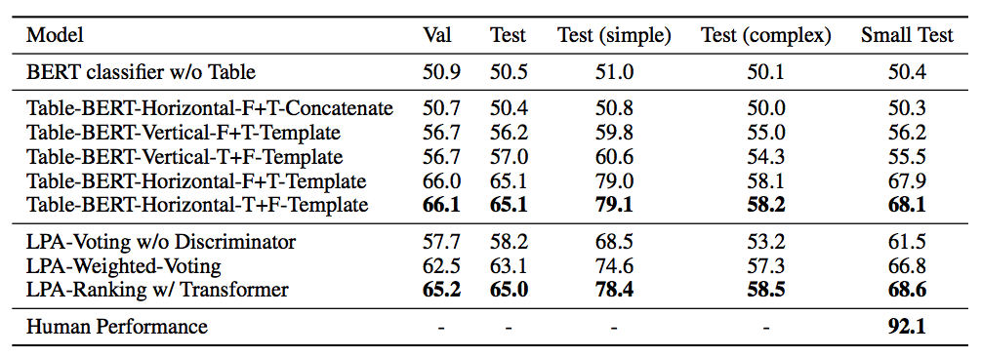
Experimental Results

Slide 78
Experimental Results

Slide 79
Experimental Results
Latent Program Analysis
Pros: robust and explainable
Cons: Heavily rely on entity linking, the execution pipeline requires hand-written rules

Slide 80
Experimental Results
Latent Program Analysis
Pros: robust and explainable
Cons: Heavily rely on entity linking, the execution pipeline requires hand-written rules
Table BERT
Pros: simple and general
Cons: training unstable, black-box without explainability

Slide 81
Conclusion
This paper investigates an underexplored fact verification problem under structured data and release a dataset to promote research in this area.

Slide 82
Conclusion
This paper investigates an underexplored fact verification problem under structured data and release a dataset to promote research in this area.
Both Proposed Symbolic and Neural models have pros and cons.

Slide 83
Conclusion
This paper investigates an underexplored fact verification problem under structured data and release a dataset to promote research in this area.
Both Proposed Symbolic and Neural models have pros and cons.
How to design a more powerful model to combine linguistic and symbolic reasoning remains an open problem.

